Slide 1
Rohinee G
Final Project – Parkinson’s Disease Detection
3/21/2024 Annual Review

Slide 2
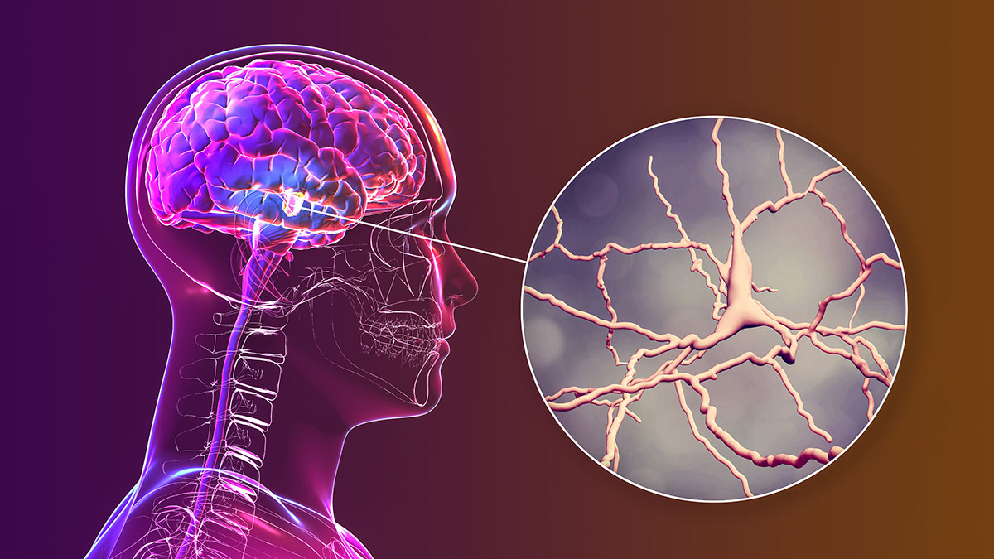
PARKINSON’S DISEASE DETECTION

Slide 3

AGENDA
Parkinson’s disease is a neurological disorder that affects the central nervous system.
This leads to slowed movements, balance problems, rigidness or stiffness, difficulty in swallowing, walking gait and tremors.
It also leads to loss of motor functions.
This disease causes a part of brain, basal ganglia to deteriorate.
Due to this, our body functions and movements are affected.
The nerve cells die and deteriorate due to which the secretion of a neurotransmitter, dopamine, is reduced.
Neurotransmitters aids in the communication between brain cells.
Due to lesser release of dopamine, the communication between the brain cells is hindered.
This leads to slowed movements and tremors.
As the disease progresses, all the symptoms expand and intensify.
It causes dementia-like signs and symptoms to older people.
3/21/2024 Annual Review

Slide 4

PROBLEM STATEMENT
The aim of the project is to develop a model that detects the presence of Parkinson’s disease with the help of voice signals using Convolutional Neural Network (CNN).
The aim of the project is to detect the disease in a short period of time with high accuracy and sensitivity.
The dataset contains 195 records, 24 columns, and as presented, a series of biomedical voice measurements.
3/21/2024 Annual Review

Slide 5

PROJECT OVERVIEW
There is no cure for Parkinson’s disease.
The detection of this disease is also difficult.
It takes weeks for the results to come and the accuracy rate is also less.
So, there is a need for us to develop a model that will detect the disease in a very short period of time with high accuracy and sensitivity.
This will help save the lives of the patients by identifying the symptoms quickly and then providing early medical attention.
This will also be cost-effective for the patients.
This model will reduce the time and effort of the medical staffs.
Here, the disease detection is done using voice signals.
The vocal cords (voice box) of the patients are affected. Due to this, their voice will be different from normal humans in terms of frequency, pitch and amplitude.
This enables the model to detect the disease from the voice signals.
3/21/2024 Annual Review

Slide 6

WHO ARE THE END USERS?
The end users are patients who want to test if they have the disease and medical professionals who use the model to assess the severity of the disease.
The patients who show the symptoms of this can use this model for detecting the presence of the disease rather than taking a physical examination as it is less time consuming and highly accurate.
3/21/2024 Annual Review

Slide 7
DATASET
The dataset was created by Max Little of the University of Oxford, in collaboration with the National Centre for Voice and Speech, Denver, Colorado, who recorded the speech signals. The dataset is available in Kaggle. The original study presented feature extraction methods for general voice disorders.
The study included voice recordings from 31 people, including 23 people with Parkinson's Disease (PD) (16 males and 7 females) and eight Healthy Controls (HC) (males = 3 and females = 5). The dataset contains 195 records, 24 columns, and as presented, a series of biomedical voice measurements. It is divided into columns that represent each of the voice measurements and rows which represent vocal recordings from individuals.
Each row corresponds to one voice recording for 36 s. The voice was recorded in an industrial acoustic company sound-treated booth by a microphone placed 8 cm from the mouth.
In the dataset, the “status” column is set to 0 for HC and 1 for those with PD, to distinguish healthy individuals from those with PD.

Slide 8
Voice measure | Meaning
Name | ASCII name of subject and recording number.
MDVP:Fo(Hz) | Average vocal fundamental frequency (Numerical variables).
MDVP:Fhi(Hz) | Maximum vocal fundamental frequency (Numerical variables).
MDVP:Flo(Hz) | Minimum vocal fundamental frequency (Numerical variables).
MDVP:Jitter(%)
MDVP:Jitter(Abs)
MDVP: RAP | Several measures of variation in fundamental frequency (Numerical variables).
MDVP: PPQ
Jitter:DDP
MDVP:Shimmer
MDVP:Shimmer(dB)
Shimmer: APQ3 | Several measures of variation in amplitude (Numerical variables).
Shimmer: APQ5
MDVP: APQ
Shimmer:DDA
NHR | Measures of the ratio of noise to tonal components in
HNR | the voice (Numerical variables).
status | 0 for HC and 1 for PD (Numerical variables).
RPDE | Nonlinear dynamical complexity measures (Numerical variables).
D2
DFA | Signal fractal scaling exponent (Numerical variables).
spread1
Spread2 | Nonlinear measures of fundamental frequency variation.

Slide 9

YOUR SOLUTION AND ITS VALUE PROPOSITION
The model is developed using Convolutional Neural Networks (CNN).
This project is executed in Google Colaboratory.
Necessary libraries are imported for creating the model.
The dataset is imported from Kaggle.
The data is pre-processed to remove duplicate values and missing values.
The model is divided into training and test sets.
The highly needed features are identified using Feature Selection.
The feature scaling is performed to bring all the data into the same range of 0 to 1.
Pooling and flattening is performed on the model.
Then, the dataset is trained with the neural network.
There are 220 input layers, 360 hidden layers and 1 output layer and the relevant activation functions are specified.
After training, the performance of the model is evaluated by constructing the confusion matrix and classification report.
The accuracy of the model is identified using accuracy_score module from sklearn.metrics.
3/21/2024 Annual Review

Slide 10

THE WOW IN YOUR SOLUTION
This model uses Convolutional Neural Networks.
The model shows an accuracy of 92.3% which is quite good.
This proves that the model is highly accurate with a precision of about 91%.
Also, the model is highly sensitive.
This model will provide the results in a very short period of time.
Fast delivery of results will ensure that the patients get the necessary medical treatments for reducing the severity of the disease.
Although there is no cure for this disease, proper treatment can be given to the patients and thereby we can save their lives.
This model will reduce the time, workload and effort of the healthcare professionals.
Voice signals can easily be measured which will reduce the burden of both the patient and healthcare professionals.
This solution is cost-effective.
3/21/2024 Annual Review
10

Slide 11
PERFORMANCE EVALUATION
In a confusion matrix, actual class instances are represented as rows, while predicted class occurrences are represented as columns. The four possible outcomes: True Positives (TP), True Negatives (TN), False Positives (FP), and False Negatives (FN).4
False Positive (FP): The number of instances that are misclassified as positive.
False Negative (FN): The number of instances that belong to the target class but are misclassified as negative.
Accuracy: Is the probability that a diagnostic test will be carried out accurately. Accuracy displays the classification system's total performance.
Sensitivity/Recall: Is a measure for how thorough classifier is; it measures the capacity to identify every positive instance.
Precision: Can be considered a measure of how exact a classifier is. It is described for each class as the proportion of true positives to the total of true and false positives.
F1-Score: It is the precision and recall of the harmonic mean. It takes both false positives and false negatives into account.

Slide 12
MODELLING
Parkinson’s disease
Importing the libraries
Importing the dataset
Data preprocessing
Splitting the dataset into training and test set
Model prediction
&
Calculating accuracy
Training the model with convolutional neural network
Feature Scaling
3/21/2024 Annual Review
12

Slide 13
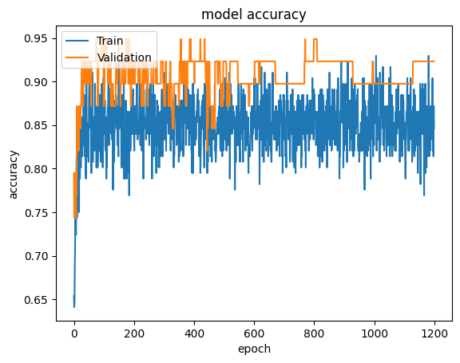
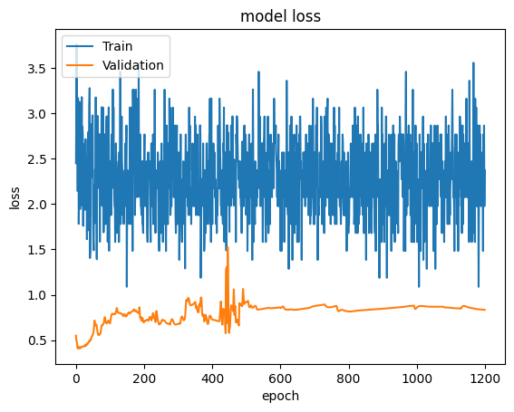
RESULTS
The accuracy of the model has increased by 30% from other classification algorithms like decision tree, random forest etc.
The loss of the model has significantly been reduced and the accuracy of the model has improved upon validation.
13

